Slide 1
DATA STRUCTURE AND ALGORITHM
Name: Evode MUYISINGIZEMWESE REG NUMBER: 223005316
PYTHON PROJECT
“ ONLINE TUTORING SYSTEM”

Slide 2
Online Tutoring System: Stack for undoing session bookings, queue for scheduling lessons, and list to manage available tutors

Slide 3
OVERVIEW
OTS(Online Tutoring System)
An online tutoring system is a virtual environment where Users especially students and tutors can interact to provide education without being in the same physical location.
Online tutoring can be conducted in a variety of ways, and students and tutors may communicate through email or other web-based tools to communicate the time for conducting lessons.
This Program will include:
Stack for undoing booked sessions,
Queue for scheduling lessons and
List to manage available teachers/tutors.

Slide 4
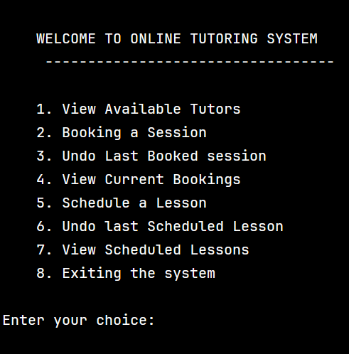
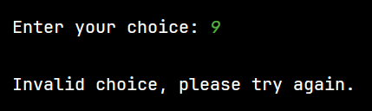
Overview of program (OTS)
Options To be selected from menu
Description
This act as the heart of the Online tutoring system(OTS).
This describes the possible options that a user(student) can choose from depending on what he/she needs.
Users have to select option(1or 2..)as indicated in the menu. If he/she tries to select a choice apart the menu, the program says ‘’invalid choice’’

Slide 5
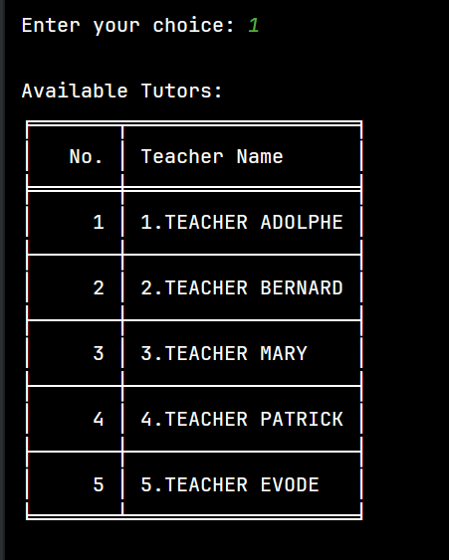

List to manage available tutors/teachers
When a student want to check the available teachers/tutors, he/she selects option ‘1’. After selecting 1, the program calls the function called
This function will fetch the list of tutors stored in variable called available_tutors and print the list in table as shown in the figure.

Slide 6
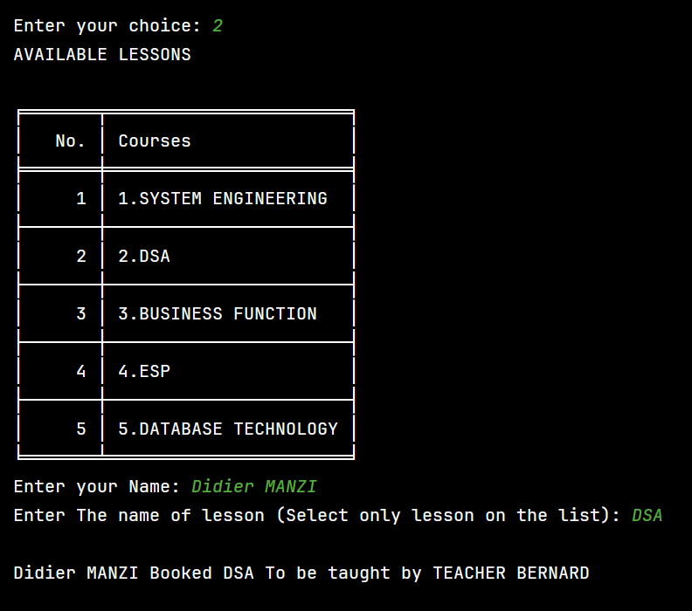
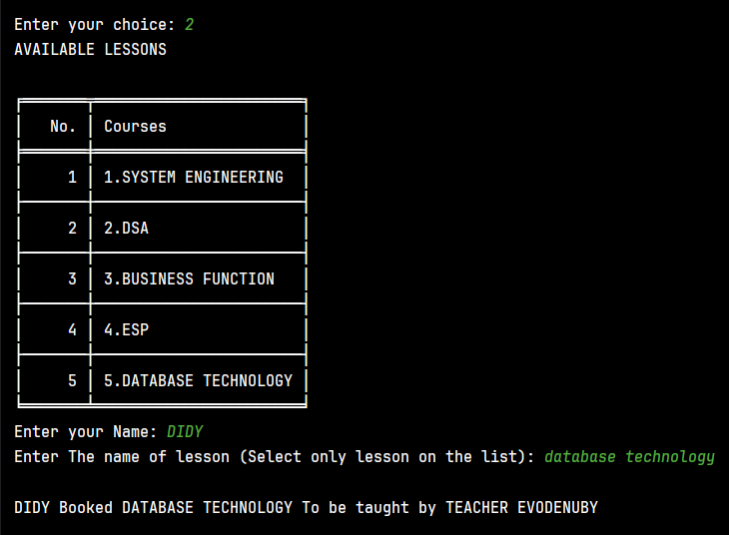
2. Booking a session
If a student selects option 2, he/she can book a session as per courses available above. Then The system asks him/her to enter their names, the after enter the name of course as indicated in previous table portraying available lessons.
If student selects a lesson which is not in the available lessons , the program will tell him/her to try ag

Slide 7
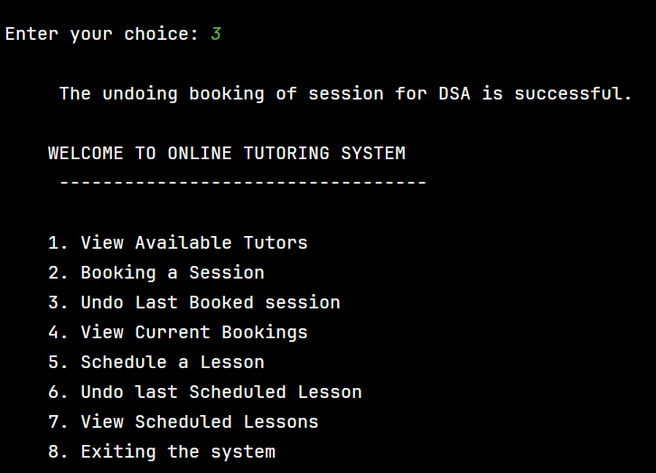
3. Undoing last booking
At this stage ,if he/she selects choice 3,
The system removes the last booking made automatically
(stack : last in first out)

Slide 8
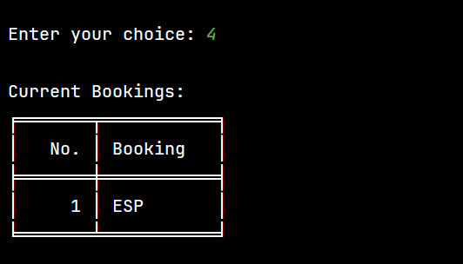
4. View current bookings
At this stage ,if he/she selects choice 4,
The system calls the function called
Print_bookings()
and displays the booked sessions output as shown in the picture
The output displays only ESP because we have removed the last booking in the previous slide.

Slide 9
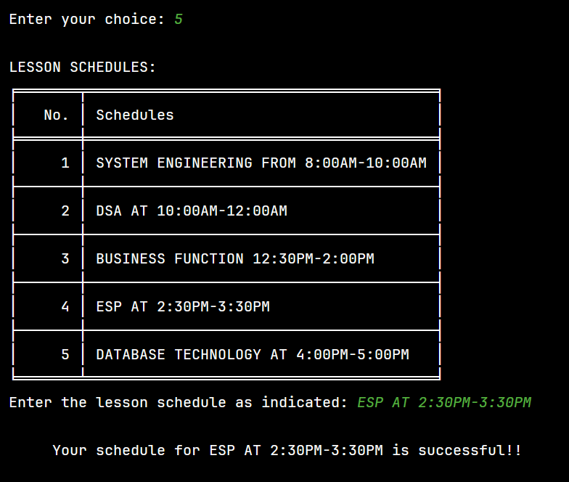
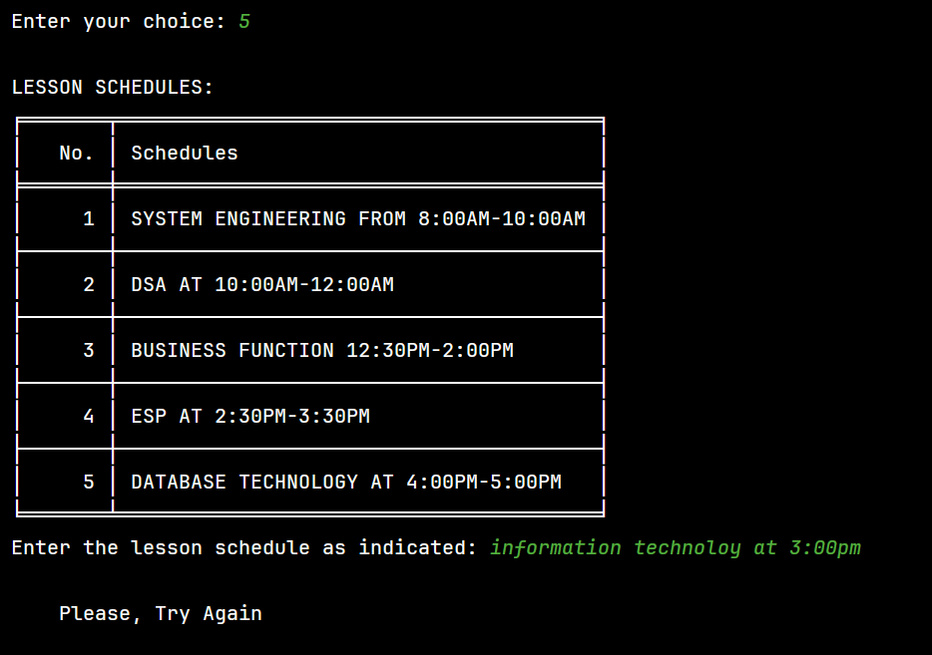
5. Schedule a Lesson
At this stage ,if he/she selects
choice 5, The system Displays the lesson schedules and asks them to enter the lesson as indicated. Then logs the message for successful schedule.
If they enter lesson schedule apart from the list, the system tells them to try again as indicated in most left image

Slide 10
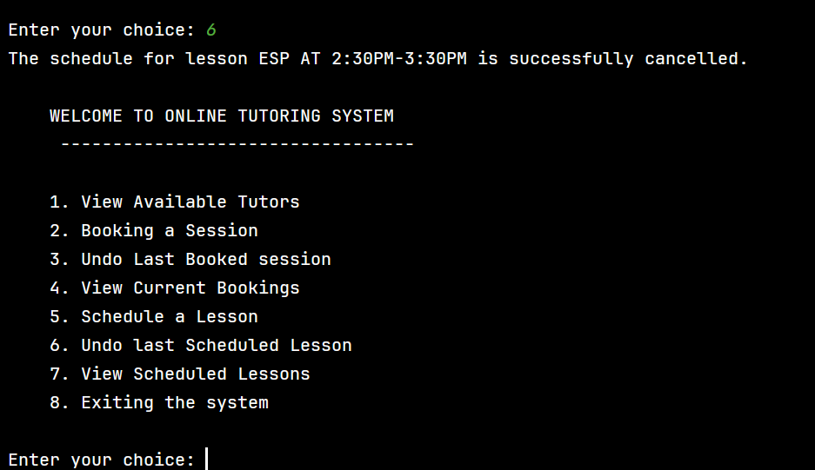
6. Undo first scheduled lesson
At this stage ,if he/she selects choice 6,
The system removes the first schedule made automatically
(queue : first in first out)

Slide 11
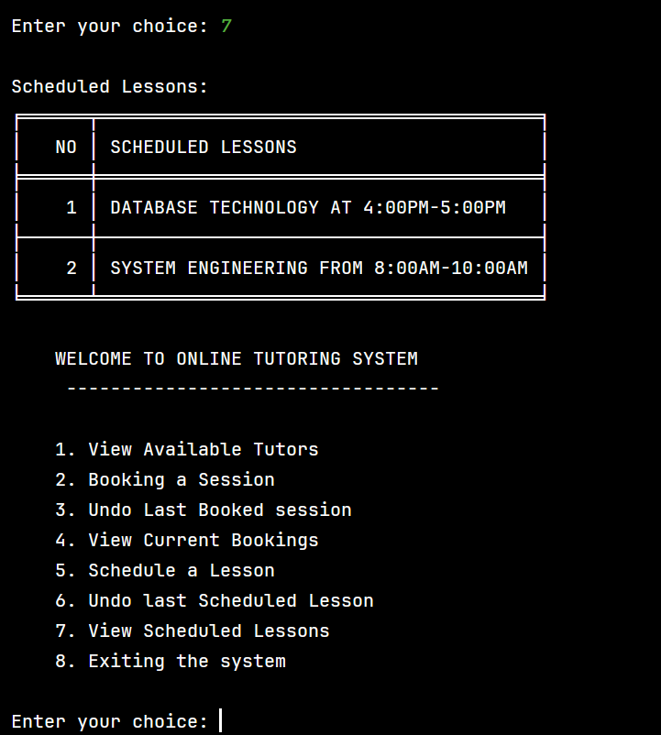
7. View scheduled lessons
At this stage ,if he/she selects choice 7,
The system calls the function called
Print_scheduled_lessons()
and displays the scheduled lessons output as shown in the picture
The output displays only these schedules because we have removed the first schedule in the previous slide.

Slide 12
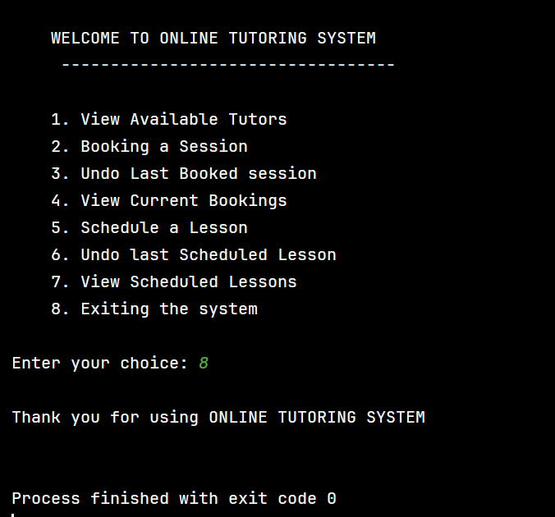
8. Exiting the system
Finally when a user selects choice 8,
the system terminates.
As indicated in the picture

Slide 13
THANK YOU !!!!!!!!!!!!!!!!!!!!!!!!!!!!!!!!!!
Evode MUYISINGIZEMWESE
223005316

